Slide 1
FROM CHAOS TO
COLLABORATION
Leadership Tools for Increasing Individual Accountability and Turning Excuses Into Results
@alexmdorr

Slide 2
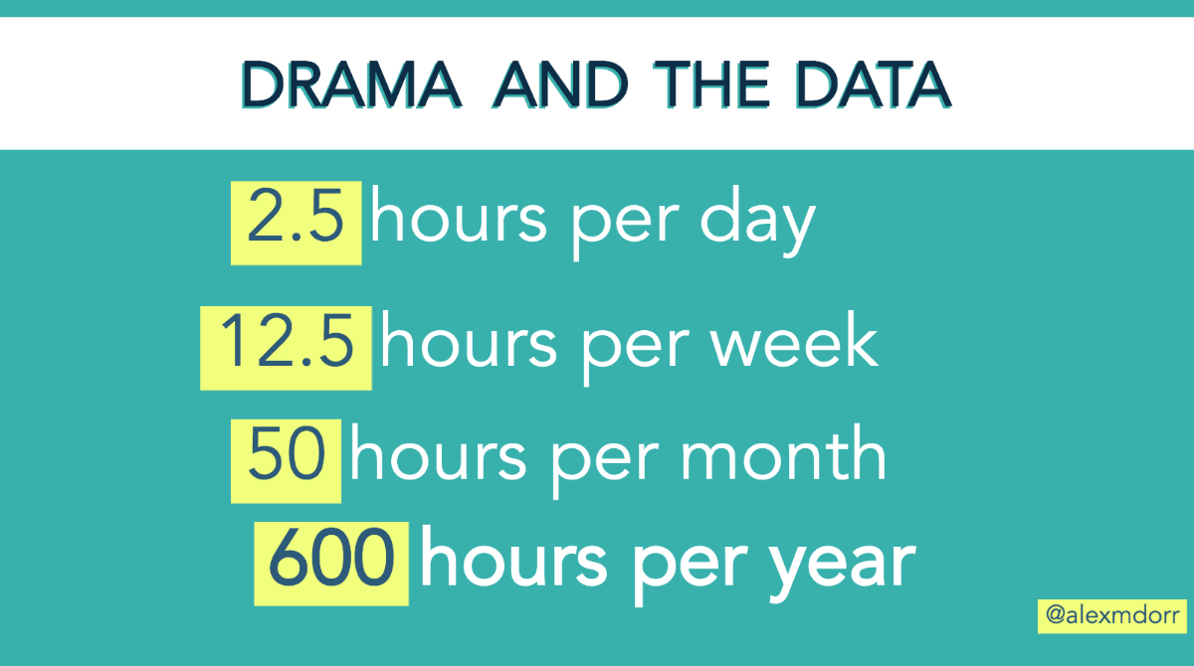

Slide 3




UNDERSTANDING THE HUMAN CONDITION

Slide 4

@cywakeman

Slide 5
THE BIG OPPORTUNITY
The space
for impact.
Unpreferred reality
Ideal future?

Slide 6
REFLECTION:
GIVEN THAT…
HOW COULD WE?
@alexmdorr

Slide 7

@cywakeman

Slide 8
EVERYONE NEEDS TIME TO VENT?
Venting is the ego’s way of avoiding self reflection
Accountability silences the ego
Self-Reflection cultivates accountability

Slide 9
Sharing a feeling
is different from venting.

Slide 10

HARDWIRING ACCOUNTABILITY

Slide 11

HIGH-SELF
‘TOGGLE UP’
LOW-SELF

Slide 12

What would great look like?
What can I do to help?
What do I know for sure?
What can I do to add value?
@cywakeman

Slide 13

HIKING IN
SPAIN

Slide 14
WHAT DO YOU KNOW
FOR SURE?

Slide 15
How often are you turning ropes into snakes?

Slide 16
COACHING TOOL – “HEY, DO YOU HAVE A MINUTE?”
Information Processing
S Situation (one sentence)
B Background (relevant)
A Analysis (expertise not opinions)
R Recommendations (2-5 ideas with cost/benefit for each)

Slide 17
All tools end with
Who? Doing what?
By when?
(or the conversation didn’t happen)

Slide 18

Get the free SBAR download and video here!

Slide 19
IDEA:
CHANGE IS HARD.

Slide 20
CHANGE IS ONLY HARD FOR THE UNREADY…
@alexmdorr

Slide 21


THREE TYPES OF EMPLOYEE MINDSETS
VISION
RESISTANCE
MAINTENANCE
Play it Safe
Lacks Meaning
Don’t Care
Past/Future
Opportunity
Creativity
Resource
Present
Threat
Belief
Reaction
Past
ISSUE
EVENT
or
@alexmdorr

Slide 22


ENERGY MANAGEMENT
WORK WITH THE WILLING
WHY WE CAN’T to
HOW WE COULD

Slide 23
LEADERS
MANAGE ENERGY,
NOT PEOPLE.

Slide 24
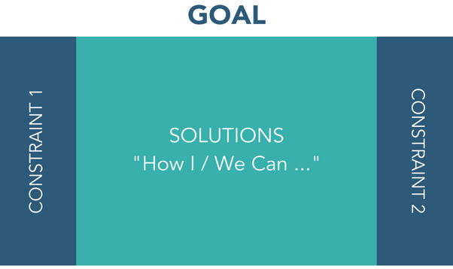
THINKING INSIDE-THE-BOX TOOL
More sleep
12 Hour Shifts
No Extra Time

Slide 25
Update skillset?
Modernize approach?
Level of willingness?
Notes:
LINK TO POINT OF – “THE JOBS ARE JUST GETTING UNDOABLE”
50 cases, now managing 100 cases. Current skillset, current approach, current level of willingness. You’re right.
40 patients a day - doctors

Slide 26

Ready to start using the tools?
Get your cheat sheet download here.

Slide 27
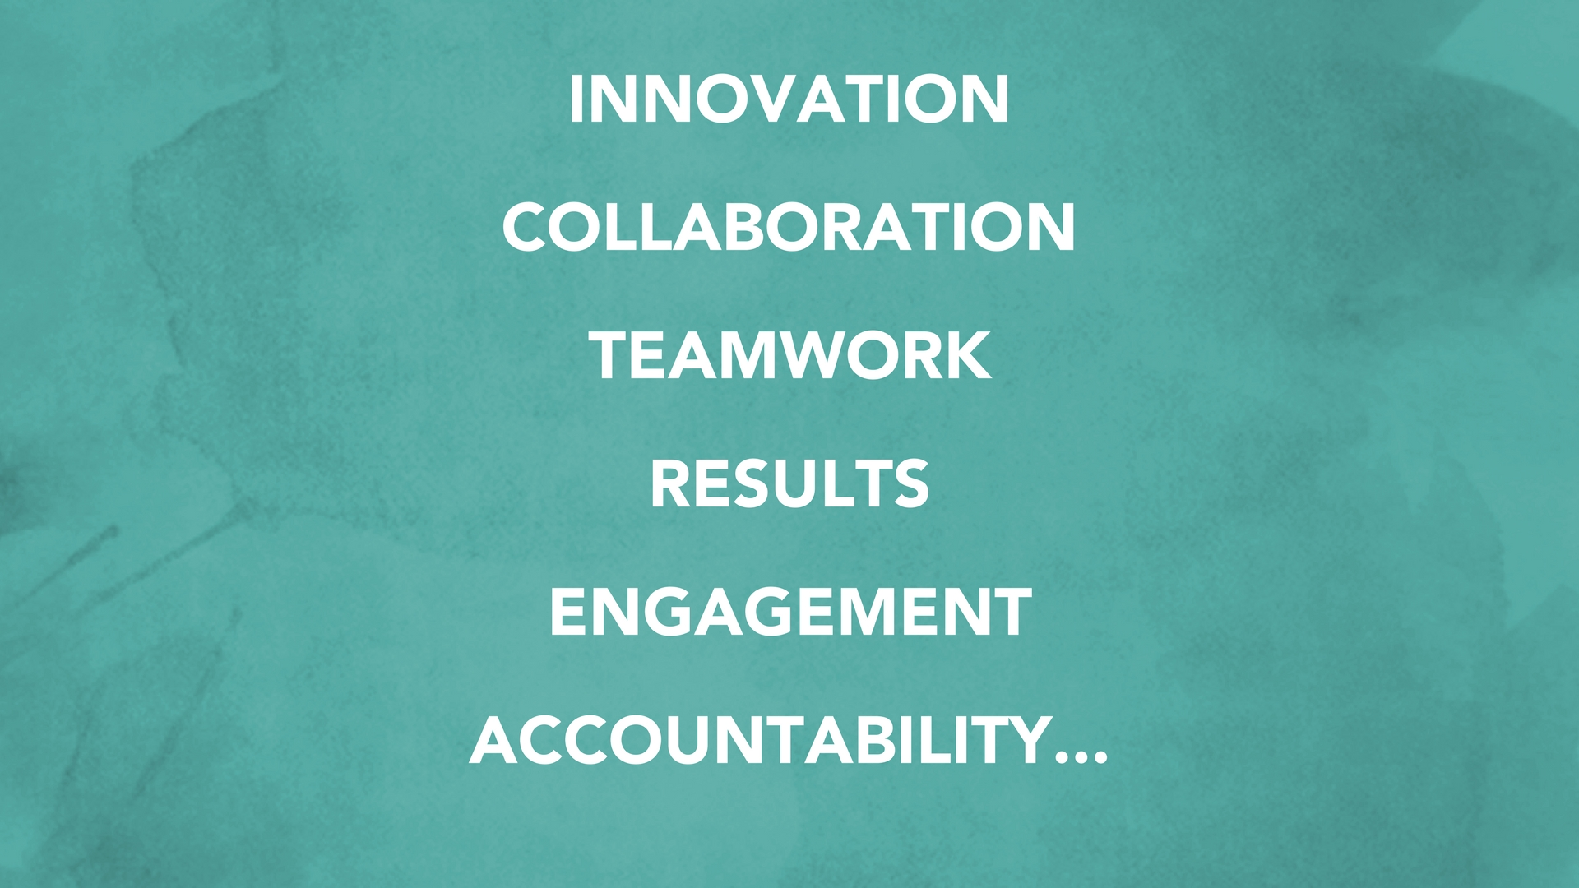

Slide 28

@alexmdorr

Slide 29

So, what’s your drama level?
Get the automatic calculator here.

Slide 30
FROM CHAOS TO
COLLABORATION
Breakout Session: Putting the Thinking Inside-the-Box tool to use to stop excuses, create problem-solvers and unlock innovation
@alexmdorr

Slide 31
THE EGO THRIVES ON
VERBAL DIALOGUE
AND AMBIGUITY

Slide 32
WHEN TO USE THE THINKING INSIDE-THE-BOX TOOL?
When someone is giving the constraints, excuses or circumstances for why they can’t succeed
When you are navigating competing priorities on a project
When two departments seem to have competing goals that are preventing progress, innovation or collaboration
When an individual is asking you, "Would you rather us do this OR this? You can only choose one." Ex: Would you rather us do this quickly OR with high quality?”

Slide 33
WHY WE CAN’T
WHY WE CAN’T
HOW WE COULD

Slide 34
EXAMPLE #2 – COMPETING PRIORITIES
Growth/Sales
Marketing: on brand/buttoned up.
Sales: Collateral to get in front of customers just-in-time

Slide 35
HOW TO SET UP THE REFLECTION TOOL?
WRITE YOUR GOAL HERE
List the constraints, excuses, competing priority or department goal here
List the additional constraints, excuses, reasons for ‘why we can’t’ or competing priority here

Slide 36
A SCRIPT TO INVITE YOUR TEAM TO THE TOOL
”Given our goal is ________ and given our constraints in our reality (list them out),
how could we move forward?
What ideas do you have?”

Slide 37
Update skillset?
Modernize approach?
Level of willingness?

Slide 38
TOOL 2 – INSIDE THE BOX
Discuss opportunities where outside-the-box thinking is leading to arguments with reality
Share how going ‘inside-the-box’ may be a better approach and common places you could do so with your team
Use the “Thinking Inside the Box” Tool as if you were the team involved in impacting the situation and find ways you could influence the results in spite of the current circumstances.
10 minutes or so with this tool

Slide 39
A TOOL DONE
MESSILY
IS BETTER THAN
NO TOOL AT ALL.

Slide 40
Ready to start using the tools?
Get your cheat sheet download here.

